Slide 1
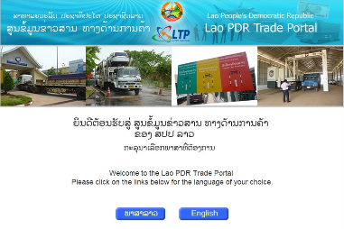
Comparison between
Lao PDR Trade Portal and
And National Trade Repository

Slide 2
What is the Lao PDR Trade Portal?
A website that contains all regulatory trade related information, i.e.
  All laws, regulations and other legal instruments
  All license and permit requirements, prohibitions, restrictions, technical standards, SPS measures
  Entire commodity classification and tariffs
  All procedures for license/permit application and clearance
  Copies of all forms
All information is indexed, cross-referenced and dynamically presented
Notes:
In the case of Lao PDR the LTP uses a database where information is stored in a structured way and not (as in many websites) as loose web pages. Therefore the underlying LTP database fulfils the role of a National Trade Repository (NTR).
The shell architecture of the ATR predicates that each member state should have their own NTR. The ATR will be a central website that does not contain any data but, instead, contains links to the specific categories of information listed in Article 13 of ATIGA which should be stored in each NTR. It is therefore important that the NTR should be a structured database so that specific items of information can be easily found through a link. This would not be possible if an NTR was simply a website of unstructured text.

Slide 3
What is the Lao PDR Trade Portal?
Extensive plain language instructions
Contact Form for queries targeted to specific agencies
Help features
Market access information
Latest news, announcements, events and publications
SPS and TBT Enquiry Points
Value added subscription facilities
Dual language (Lao and English)

Slide 4
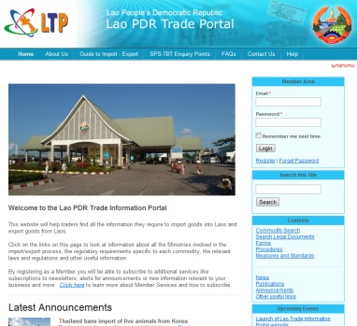
Trade Portal and NTR share the same Database
Lao PDR Trade Portal
Other Databases (e.g. ASEAN Trade Repository)
Trade Information Database
(NTR)

Slide 5
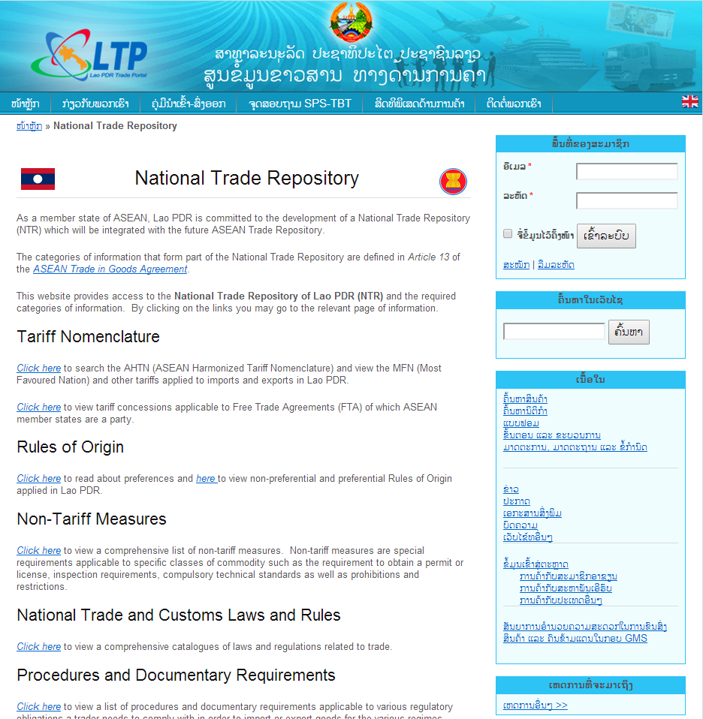
NTR and LTP
  The NTR Can be accessed via a dedicated page on the LTP
http://laotradeportal.net/index.php?r=site/display&id=698

Slide 6
The Nine categories of NTR are listed in Article 13 of ATIGA
Tariff Nomenclature
MFN tariffs, preferential tariffs offered under this Agreement and other Agreements of ASEAN with its Dialogue Partners
Rules of Origin
Non-Tariff Measures
National Trade and Customs Laws and Rules
Procedures and Documentary Requirements
Administrative Rulings
Best Practices in Trade Facilitation
List of Authorized Trader

Slide 7
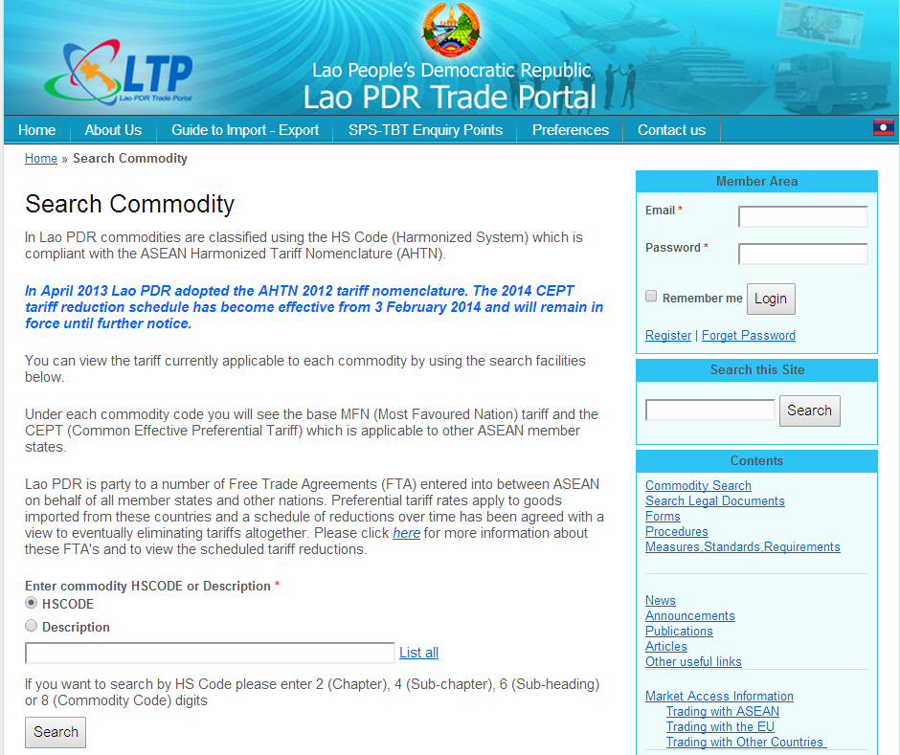
Which categories that LTP are complied
Tariff Nomenclature:
  The LTP has a full interactive AHTN tariff nomenclature with search by chapter, sub-chapter, sub-heading, full HS Code and any combination of keywords.
  http://laotradeportal.net/index.php?r=tradeInfo/index

Slide 8
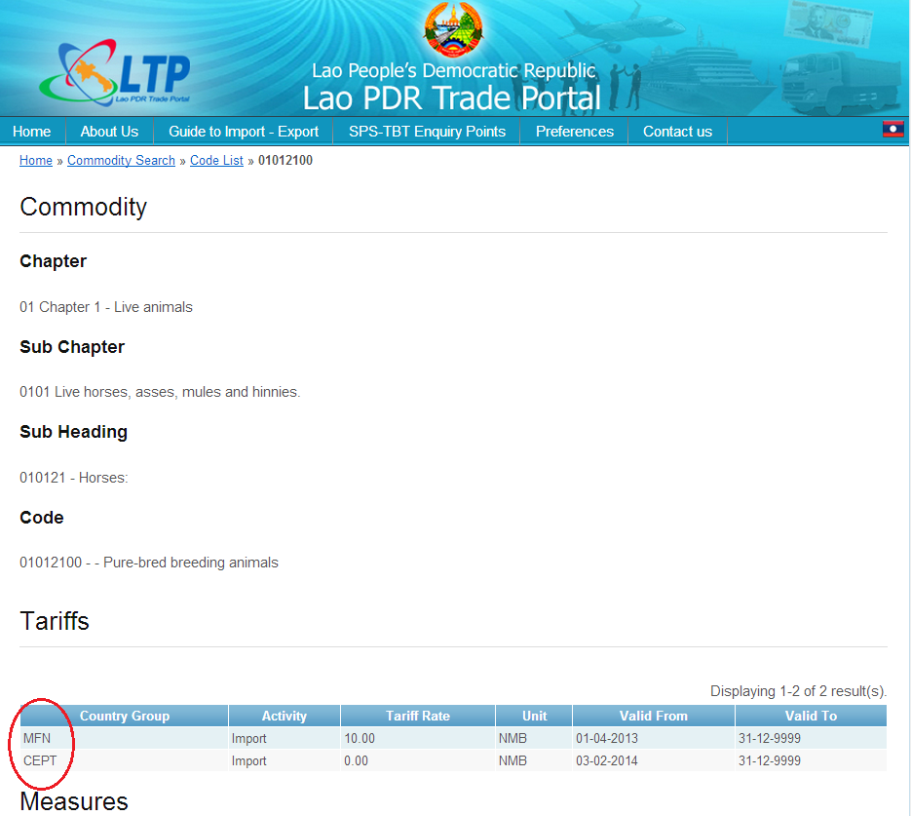
Which categories that LTP are complied con…
MFN tariffs, preferential tariffs offered under this Agreement and other Agreements of ASEAN with its Dialogue Partners:
The MFN and AHTN tariffs are published interactively as part of the Tariff search facilities above. All the other preferential tariffs (Japan, Korea, India, ANZ, China) are also published including future reduction commitments. We are planning to develop a full interactive facility to enquire on these tariffs as well in the near future.
http://laotradeportal.net/index.php?r=tradeInfo/view&id=6531

Slide 9
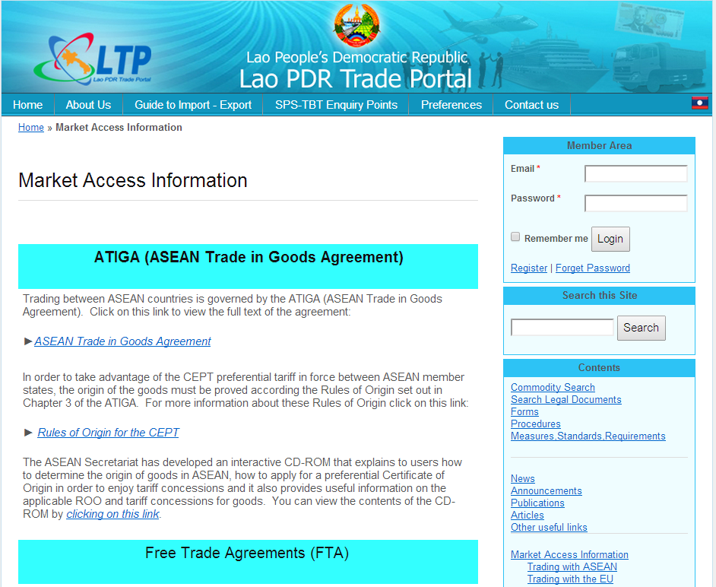
Which categories that LTP are complied con…
Rules of Origin:
ASEAN ROO’s are fully published including a link to the ASEAN interactive online CD-ROM.
http://laotradeportal.net/index.php?r=site/display&id=595

Slide 10
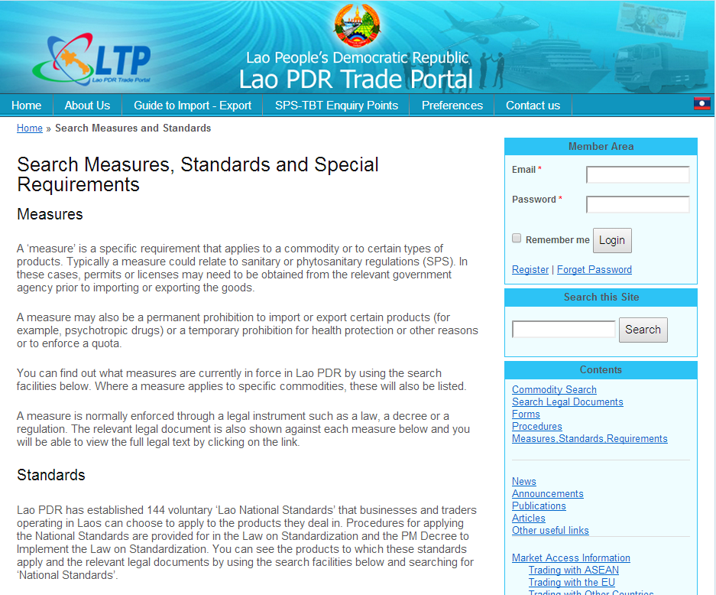
Which categories that LTP are complied con…
Non-tariff measures:
All NTMs that we identified are published including SPS and TBT. We have currently identified and published 229 NTMs and 144 technical national standards. NTMs are interactively linked to the commodity that they apply to, the procedure to follow, the ministry that administers it and the item of law that enforces them.
http://laotradeportal.net/index.php?r=SearchMeasures/index
Notes:
DIMEX is now well advanced in the process of identifying NTMs as part of an ASEAN-wide commitment to classify, harmonize and streamline NTMs. The LTP was used as the repository for NTMs as it allows NTMs to be classified as well as serving the function of publishing them transparently. Special facilities were built to allow NTMs to be extracted and sent electronically to the ATR in future by means of an electronic spreadsheet. The World Bank is coordinating the ASEAN-wide NTM review programme with a number of member states and these facilities were built according to these specifications. Currently 150 NTMs have been identified and classified in the LTP.

Slide 11
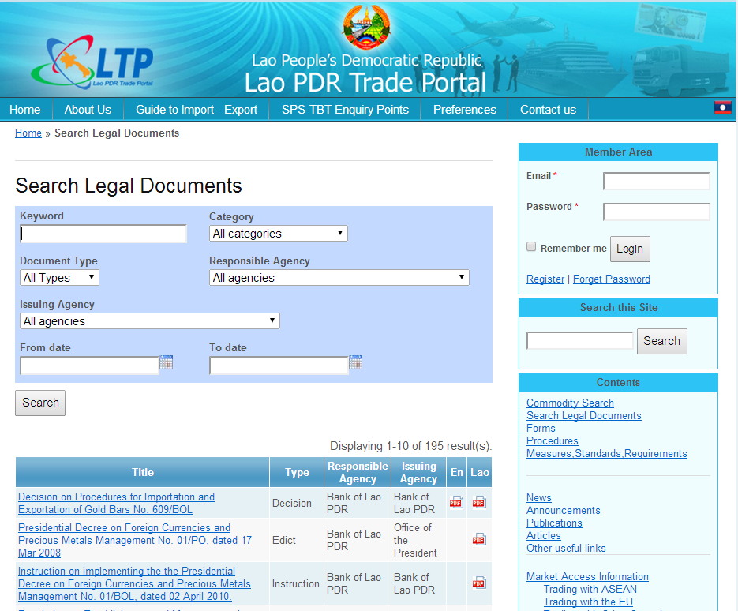
Which categories that LTP are complied con…
National trade and customs laws and rules:
All the trade related laws and subsidiary trade related legislation is published and is searchable interactively by any combination of keywords within the text and other parameters. With 166 laws and regulations, of which over 70% are both in English and Lao, this is by far the most comprehensive repository of laws (of any nature) in Laos.
http://laotradeportal.net/index.php?r=site/displaythemostrecentxx&category=Legal%20Document

Slide 12
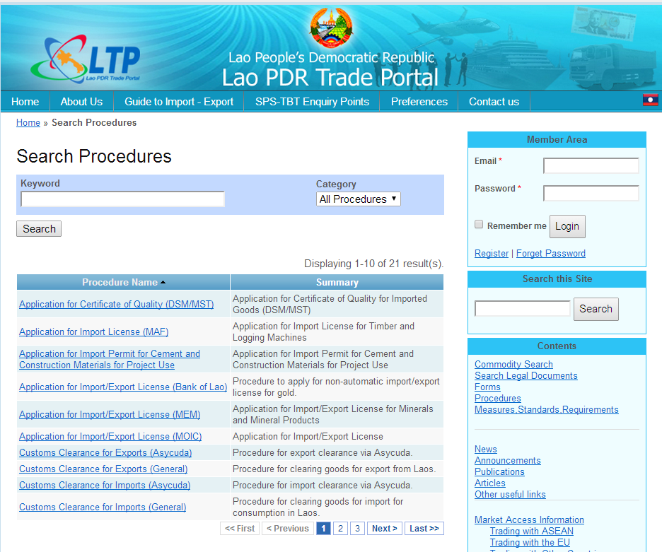
Which categories that LTP are complied con…
Procedures and documentary requirements
All procedures to obtain licenses, permits, registrations, certificates and assorted permissions including Customs clearance are published in annotated graphic form. Each procedure shows exactly what documents are required and samples of all forms are provided interactively in PDF format. Procedures are interactively linked to the measure and commodity they refer to. There are currently 21 procedures documented across all agencies.
http://laotradeportal.net/index.php?r=SearchProcedure/index

Slide 13
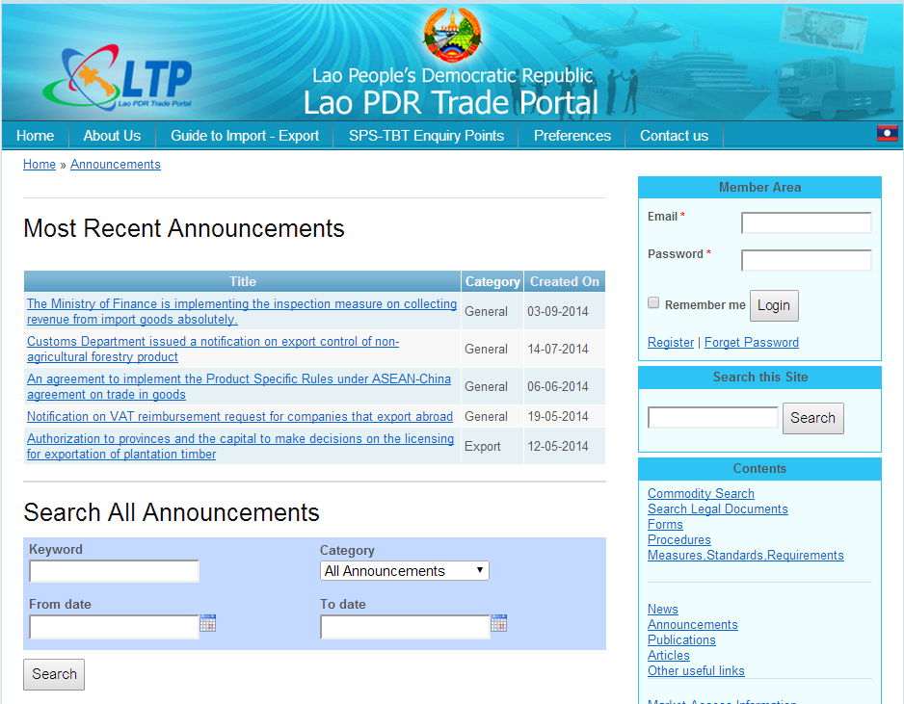
Which categories that LTP are complied con…
Administrative rulings:
This is defined as: “regulations, judicial decisions and administrative rulings of general application, which pertain to the classification or the valuation of products for customs purposes, or to rates of duty, taxes or other charges, or to requirements, restrictions or prohibitions on imports or exports or on the transfer of payments therefore, or affecting their sale, distribution, transportation, insurance, warehousing inspection, exhibition, processing, mixing or other use”.
In Laos these are published by means of instructions or notifications and will appear in the Announcements page.
http://laotradeportal.net/index.php?r=site/displaythemostrecentxx&category=Announcement

Slide 14
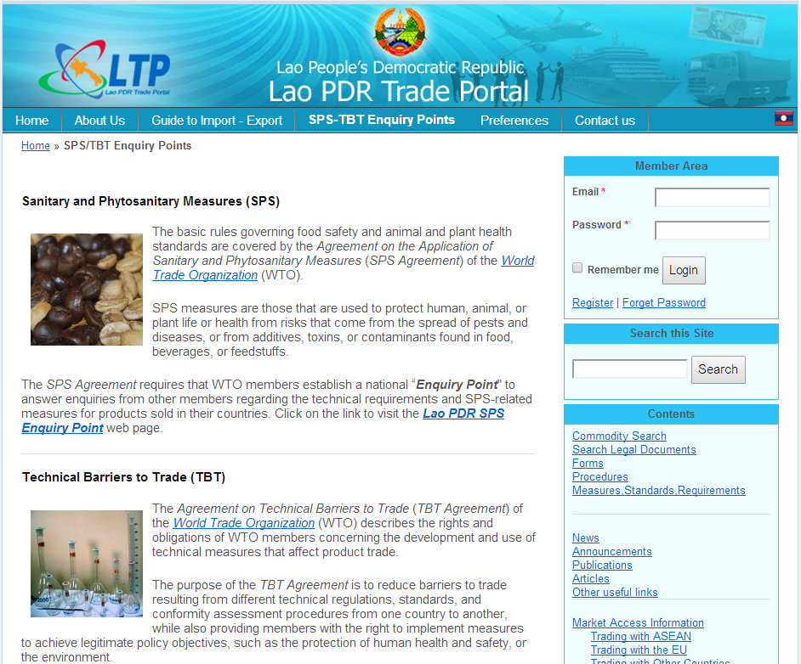
Which categories that LTP are complied con…
Best practices in trade facilitation applied by each Member State:
This category requires that any information in relations to initiatives related to trade facilitation should be published.
The LTP is currently the prime medium for publishing notices, announcements, news, publications related to trade facilitation.
http://laotradeportal.net/index.php?r=site/display&id=14

Slide 15
Which categories that LTP are complied con…
List of authorised traders of Member States:
This is intended to publish a list of Authorized Economic Operators (AEO). Currently Lao PDR is in the process of implementing an Authorized Economic Operator (AEO) or authorized trader scheme.
Notes:
In conclusion the LTP already provides all the necessary structures and content that will be required to comply with the ATR Architecture and the future NTM central database. In fact, Laos would be in a position to participate in any pilot or prototype implementation right from the start

Slide 16
Thank you!

